Slide 1


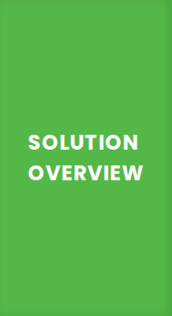



Strategic Yield Innovators
Jordan Smith • Alex Chen • Sarah Miller • David Park
TD Premium Migration & Personalized Loyalty Engine
●
Strategic Insight: Premium card users stay 2.4x longer and drive significant volume ($28.7B base).
●
The Core Strategy: Migrate the top 10% of high-potential Cash Back users into Infinite tiers for a 3x yield lift.
●
Engagement Ecosystem: Integrated TD Rewards Experience in EasyWeb featuring 30+ top merchant brands.
●
Retention Mechanics: 10% annual bonus points on birthdays to create high-emotional-value touchpoints.
FINANCIAL ROI
LOYALTY & RETENTION
PORTFOLIO SCALE
Realize 3x yield lift per active user via tier migration and defend the $28.7B First Class Travel base.
Birthday retention bonuses and NEXUS credits decrease churn risk for high-value premium travel segments.
Converts the 70% YoY growth in Low Rate accounts into a qualified pipeline for premium card adoption.

Slide 2


Image Sources
https://www.bankrate.com/brp/2025/06/17185200/travel-credit-card.jpg?auto=webp&optimize=high&crop=16:9
Source: www.bankrate.com

